Slide 1

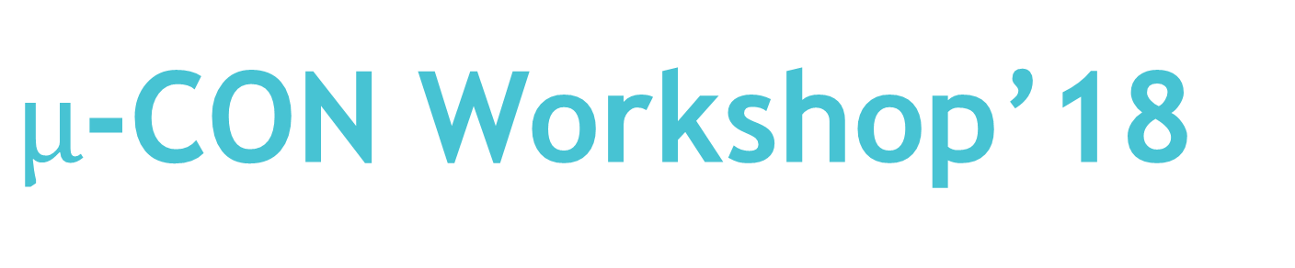
$µ$-CON Workshop’18
“ Wireless Game Controller
Using Infrared Data Transmission ”

Slide 2
Session 4: ADCs and USART
30th Sep’18, 9:00 to 12:00 Hrs.

Slide 3
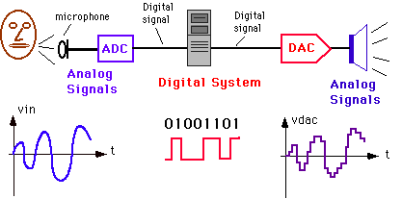
ADCs

Slide 4
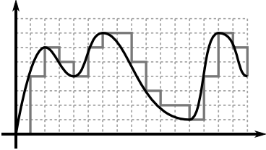
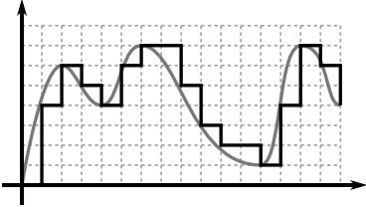
All of us use mobile phones that has a lot of sensors – ambient light sensor that makes your screen automatically bright when you go out in sunlight or dim when you’re reading in dark at night ; accelerometer that changes the screen orientation when you rotate the phone , gyroscope sensors that help you view 360 degree photos and many more.
ADC
So how do you think any
System uses
the sensor input data ?
The answer to the above question is ADC.

Slide 5
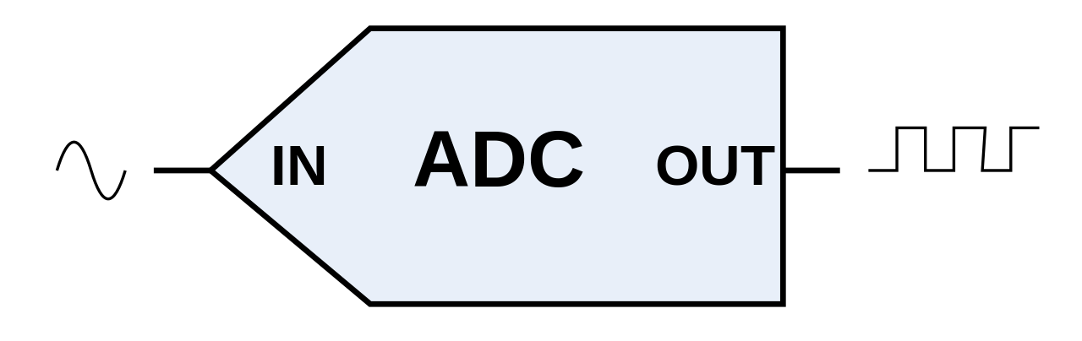
ADC
stands for Analog to Digital Converter.
Steps involved in the conversion:
Sampling
Quantization

Slide 6
Sampling and Quantization:
Analog signals that are to be digitized by an ADC normally come from sensors or transducers that capture a signal (sound, pressure, light, radio waves, etc.) and transform it into a voltage that is proportional to the amplitude of that signal.
The operation required to convert the voltage generated by the sensor to its digital equivalent is performed by the ADC as a two-stage process.
This process is illustrated by the following diagram.

Slide 7
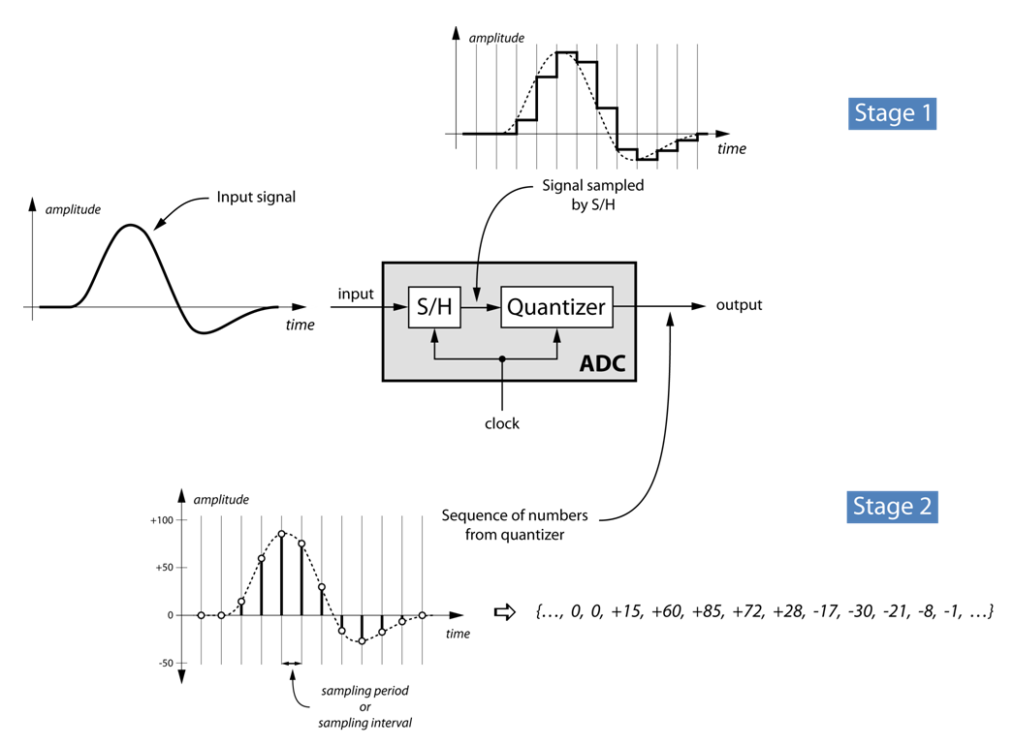
BLOCK DIAGRAM OF ANALOG TO DIGITAL CONVERSION.

Slide 8
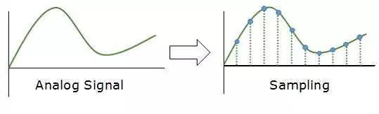
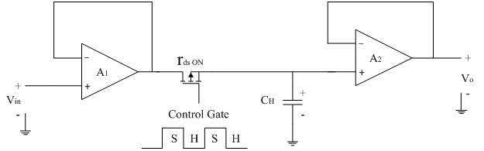
Sampling:
Storing and holding of instantaneous analog signals values at fixed time intervals.
Sampling frequency is the number of times in one sec the analog signal is sampled.
Sampling rate is inversely proportional to resolution of ADC.
Circuitry of the Sample and Hold

Slide 9
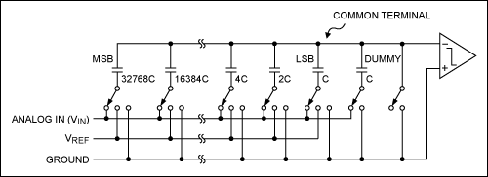
Quantization:
Once sampling is over , the values obtained are fitted into a fixed set of integers. This is called quantization.
There are a number of techniques to quantize the values.
The sampled value is fitted between 0 to 2^{N} , N being the size of the register.
The step size is V_{ref} / 2^{N}
Internal Circuitry of DAC
An N-bit ADC register (known as SAR in Arduino)
1 | 0 | 0 | 1 | 1 | 1 | 0 | 0 | 0 | 1
The value stored in this register is continuously updated , converted to decimal and then compared with the sampled value

Slide 10
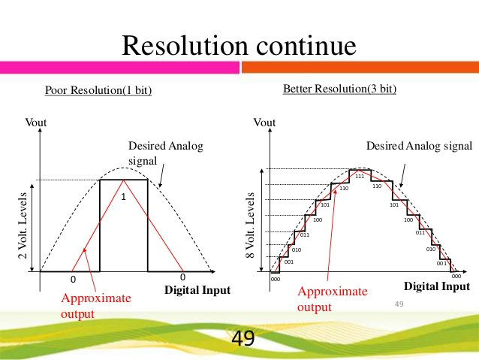
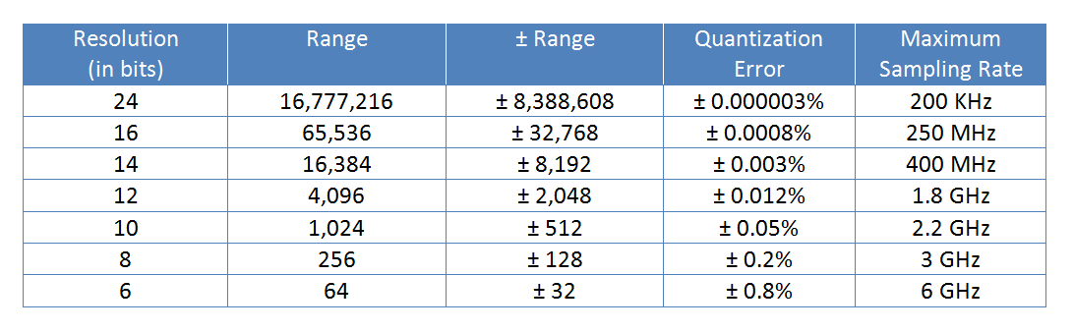
RESOLUTION of an ADC
Resolution of an ADC means the smallest input signal value ADC can accurately measure. Resolution =1/2^N for n-bit ADC.
Higher the bit size , higher is the resolution and more is the accuracy of measurement.
Does that mean then we can have any number of bits in my ADC to improve accuracy ?
Ans : In an ADC , there is a trade-off between the ADC speed and accuracy ,i.e. resolution. So there’s an upper limit for the bitsize.

Slide 11
Types of ADC:
Sigma-delta
SAR(Successive Approximation Register)
Pipelined
Interleaved
Flash

Slide 12
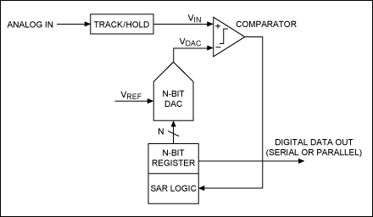
SUCESSIVE APPROXIMATION REGISTER:
The MCU that we will use – Arduino UNO, uses the SAR technique for quantization.
It is very simple. It uses something called binary search, Let’s
See how the Binary Search is formed.
A N-bit DAC is there to hold a binary number.
A reference voltage is fed to the DAC.
For the 1st comparison , MSB is set to 1 , so the output of DAC is Vref/2. It is compared with Sampled Vin. If Vref/2 >Vin then comparator will output 1. Output of comparator is fed to the DAC. If Vref/2 <Vin , then output will be set to 0 and fed to DAC such that MSB will be set to 0.
4. For next iteration , control moves to the MSB- 1 , set it to 1 and repeat the same comparison method highlighted in 3.
5. In this way an intelligent guessing is made to find an integer value as close to Vin as possible.
Simplified SAR ADC block diagram

Slide 13
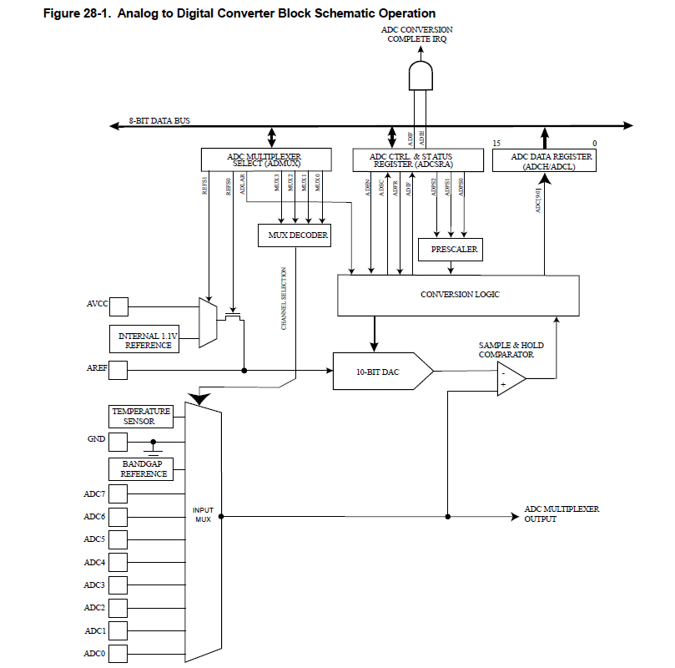
This is the block diagram of the ADC circuit in out MCU.

Slide 14

So after all this calculation and stuff , what is the final output that we get from the ADC ?
For the Arduino , the ADC outputs the value :
ADC= V_{ref}*2^{N}/V_{in}

Slide 15
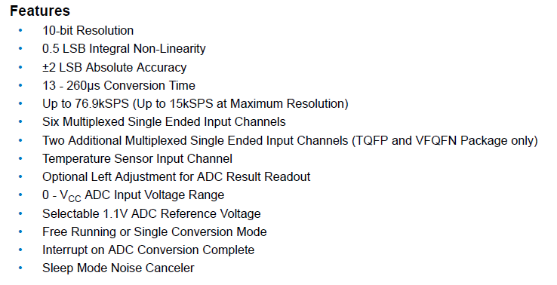
Features of ADC present in Arduino:

Slide 16
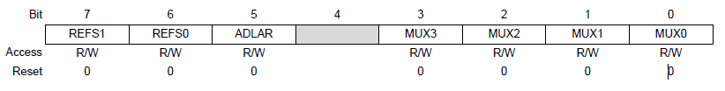
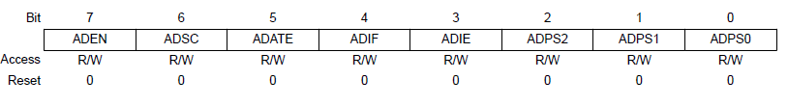
REGISTERS:
The Arduino has 4 registers for ADC. They are:
ADMUX
ADSCRA

Slide 17
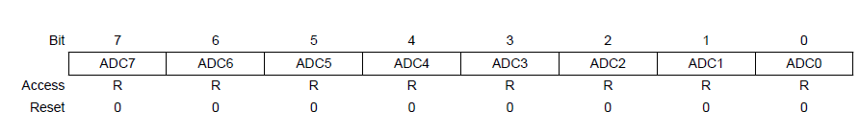

REGISTERS(Contd..):
ADC Data Register
ADSCRB

Slide 18

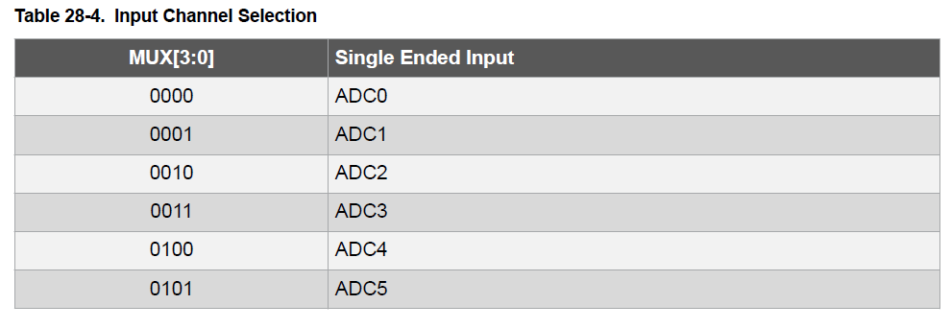
ADMUX:
ADMUX stands for ADC Multiple selection register. All the multiplexers that you saw in the block diagram before , now you’ll understand how they work.

Slide 19
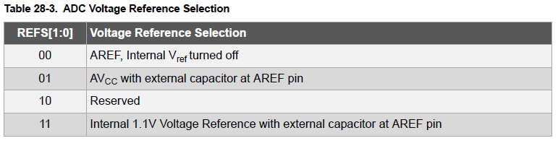
ADMUX(Contd..):
REFS[1:0]: It’s a 2-bit number that selects a Vref for ADC based on its value.
ADLAR : It’s used to right or left shift the data. We’ll see how it’s done while dealing with the ADC Data register.
MUX[3:0]: A 4-bit number that selects the ADC channel to read the data from.

Slide 20
ADSCRA:
Stands for ADC Status control register. It is like the brain or control unit of the ADC.
ADEN :
Writing 1 to this bit turns on the ADC , writing 0 turns it off. So it’s the most essential for ADC working.
ADSC:
Writing 1 to this bit starts a new conversion. It is set to 0 automatically after conversion ends. **Writing 0 explicitly has no effect.

Slide 21
ADSCRA(Contd..):
ADATE : Writing 1 to this enables auto triggering that is (setting and resetting of ADSC continuously). The ADC in MCU can work in 6 modes. We will see that later.
ADIF: ADC interrupt flag. Gets set to 1 every time a conversation ends. Can be manually written to 0 or returns to 0 at the end of interrupt service routine of ADIF.
ADIE: Writing 1 to this (along side writing 1 to I-bit of SREG) enables the ADC interrupt. Otherwise , ADIF will be set to 1 but interrupt won’t be triggered.
ADPS[2:0]: It’s a 3-bit binary number which controls what pre-scaler need to be applied on the clock frequency before given as input to ADC.

Slide 22
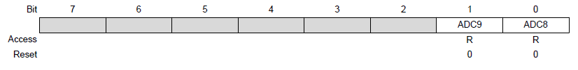
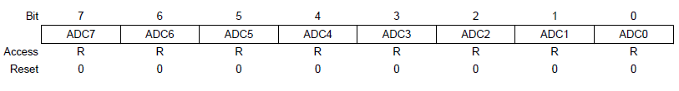


ADC Data Register:
It has two parts – ADCL & ADCH. Both of them are 8-bit storage registers(read only). Now we will see what is the function of ADLAR. Writing ADLAR to 1 left shifts the data while ADLAR=0 means it’s right shifted.
RIGHT SHIFTED:
LEFT SHIFTED:

Slide 23
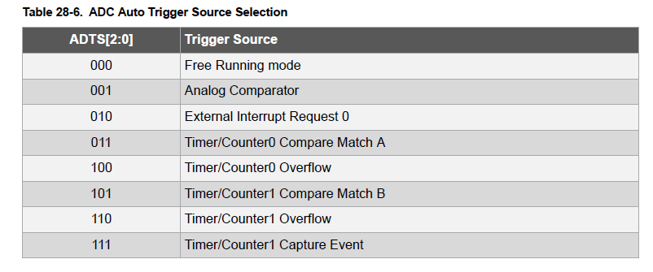
ADSCRB:
It’s main task is to control the auto triggering mode of the ADC through the ADTS[2:0] bits.
For our task , we will only be focusing on the Free running mode.

Slide 24
Finally we come to the coding part of a ADC.
Unlike understanding how an ADC works , coding is really simple.
A sample code:
#include<avr/io.h>
int main
{
Serial.begin(9600);
ADSCRA |=1<<ADEN|1<<ADIE|1<<ADATE;
ADSCRA|=1<<ADPS0|1<<ADPS1;
//setting the prescaler as 8
ADMUX |=1<<REFS0|1<<MUX0;
//adc channel 1 selected with Vref as Vcc
ADSCRA |=1<<ADSC
//conversion is starting
int x=0;
while(1)
{
while(ADSCRA&(1<<ADIF)==0);
x=ADC;
Serial.println(x);
}
return 0;
}

Slide 25
Using multiple channel of the ADC:
In ADMUX register update the the MUX[3:0] bits.
Force start the conversion by writing 1 to ADSC after updating the MUX bits.
Example :
#include<avr/io.h>
int main
{
Serial.begin(9600);
ADSCRA |=1<<ADEN|1<<ADIE|1<<ADATE;
ADSCRA|=1<<ADPS0|1<<ADPS1;
//setting the prescaler as 8
ADMUX |=1<<REFS0;
ADSCRA |=1<<ADSC
//conversion is starting
int x=0,y=0;
while(1)
{
ADMUX |=1<<MUX1|1<<MUX0; //changing channel
while(ADSCRA&(1<<ADIF)==0);
x=ADC;
Serial.println(x);
ADMUX ^=1<<MUX1;
// changing channel
while(ADSCRA&(1<<ADIF)==0);
y=ADC;
Serial.println(y);
}
return 0;
}

Slide 26

That’s it folks !

Slide 27
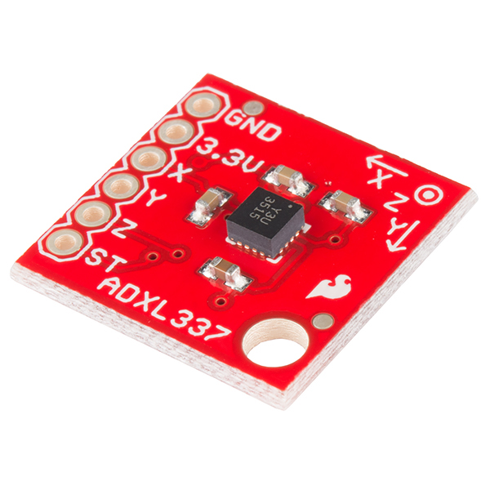
ADXL 337:
3 axis acceleration measurement instrument.
Measurement range of ±3g.
Output signals are analog voltages that are proportional to acceleration.
ST pin is Self-Test pin to forcefully make changes in values of voltages. This is used to check the functionality of accelerometer.

Slide 28
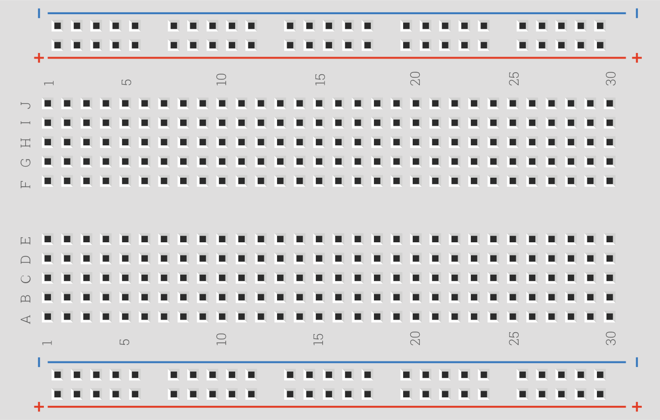
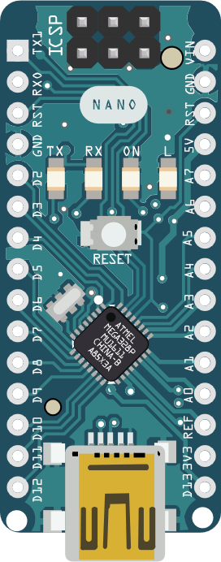
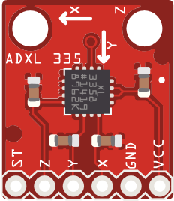
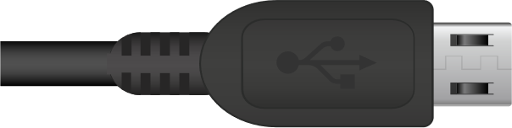
ADXL 337 interfacing with Arduino UNO :

Slide 29
Coding:
#include <avr/io.h> /* Include AVR std. library file */
#include <util/delay.h> /* Include defined delay header file */
void ADC_Init() /* ADC Initialization function */
{
ADMUX =(1<<ADLAR); /* Vref: Avcc, ADC channel: 0 */
ADCSRA = (1<<ADEN)|(1<<ADPS2)|(1<<ADPS1)|(1<<ADPS0);
}
uint16_t ADC_Read(unsigned char channel) /* ADC Read function */
{
ADMUX =(1<<ADLAR)|(channel & 0x07);/* set input channel to read */
ADCSRA |= (1<<ADSC); /* Start ADC conversion */
while (!(ADCSRA & (1<<ADIF))); /* Wait until end of conversion by polling ADC interrupt flag */
ADCSRA |= (1<<ADIF); /* Clear interrupt flag */
return ADC; /* Return ADC word */
}

Slide 30
Coding(Contd..):
int main(void)
{
uint16_t X,Y,Z;
int x,y,z;
DDRB=0xFF;
Serial.begin(9600);
ADC_Init(); /* Initialize ADC */
int flag=0;
while(1)
{
/* Read X, Y, Z axis ADC value */
X= ADC_Read(0);
Y= ADC_Read(1);
Z= ADC_Read(2);
Serial.print("X: ");
Serial.print(X);Serial.print('\t');
Serial.print("Y: ");
Serial.print(Y);Serial.print('\t');
Serial.print("Z:");
Serial.println(Z);
_delay_ms(10);
}
return 0;
}

Slide 31
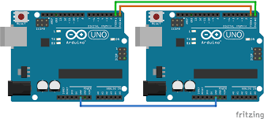
USART

Slide 32
USART:
Stands for :
Universal Synchronous/Asynchronous Receiver Transmitter.
Supports both synchronous and asynchronous transmission.
The data is sent serially with respect to the clock pulse.
The receiver peripheral receives the data when it has the same baud rate as transmitter

Slide 33
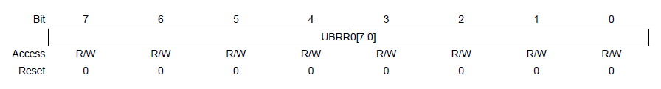
BAUD RATE:
Baud rate decides the rate of transfer of bits from input peripheral to the output peripheral.

Slide 34

The baud rate is set to UBRR register using the formula
UBRR = $\frac{fosc}{16.BAUD}−1$
Where:
f_{osc} = System clock frequency(16MHz for ATMEGA328P)
BAUD = Baud Rate in bits per second.
Q. Calculate the UBBR value for 9600bps and 16MHz system clock frequency.
ANS: 103

Slide 35
MODES OF OPERATION:
Asynchronous – The XCK pin(clock) is not used. The baud rate is set and the data is sent asynchronously.
Asynchronous 2x Mode – Results when U2X pin is set. The divisor for baud rate becomes from 16 to 8 resulting in increase in speed.
Synchronous – UMSEL is set high. The XCK(clock) pin is used. No need of baud rate. The data is sent synchronously with clock pulse.

Slide 36
FRAME FORMAT:
A frame refers to the entire data packet which is being sent/received during a communication.
A typical frame is 10 bit long ( 1 Start bit, 8-bit data, 1 Stop bit).
Order of Bits
Start bit (Always low)
Data bits (LSB to MSB) [5-9 bits]
Parity bit (optional) [Can be odd or even]
Stop bit (1 or 2) (Always high)

Slide 37
FRAME FORMAT(Contd.):
A frame starts with the start bit followed by the least significant data bit.
Then the next data bits, up to a total of nine, are succeeding, ending with the most significant bit.
If enabled, the parity bit is inserted after the data bits, before the stop bits.
When a complete frame is transmitted, a new frame can directly follow it, or the communication line can be set to an idle (high) state.

Slide 38
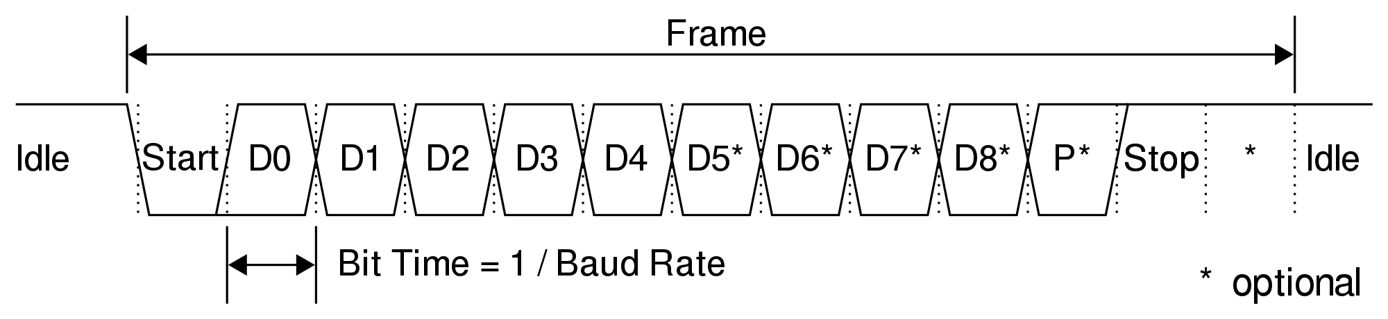
FRAME FORMAT(Contd.):

Slide 39
PARITY:
Even parity:
Even parity result in even number of ones.
When there are odd number of ones in data bits,parity bit is set high to get even number of ones.
When there are even number of ones in data bit, parity bit is set low.
Odd parity:
Odd parity results in odd number of ones.
If data bits has even ones, parity bit is set high.
If data bits has odd ones, parity bit is set low.

Slide 40
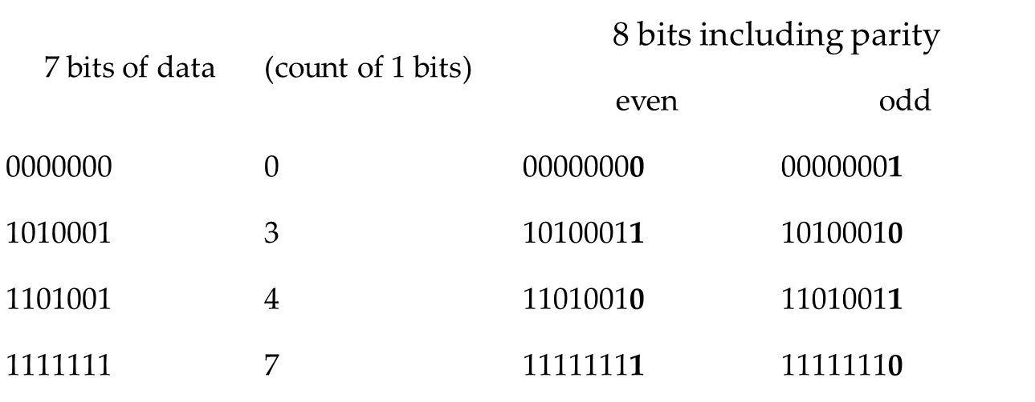
Example : 7 Bit Parity

Slide 41
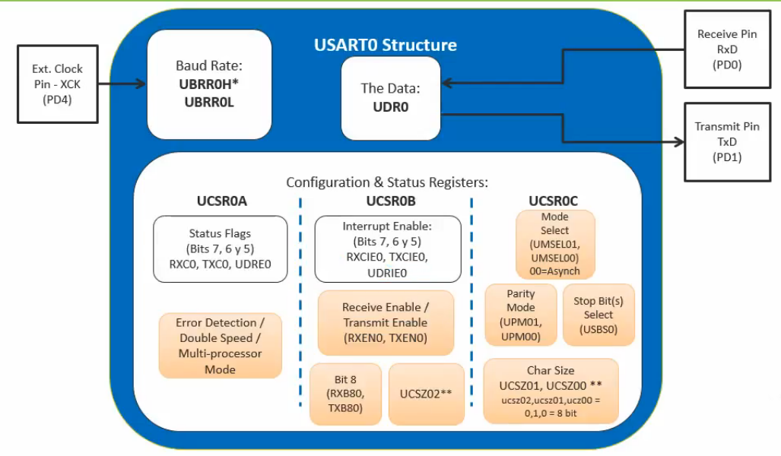
Structure of USART:

Slide 42
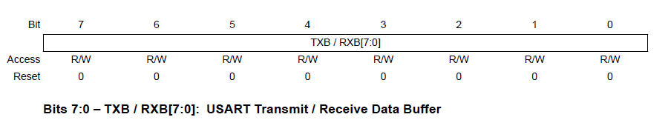
UDR: USART Data Register 0:
The USART Transmit Data Buffer Register and USART Receive Data Buffer Registers share the same I/O address referred to as USART Data Register or UDR.
The Transmit Data Buffer Register (TXB) will be the destination for data written to the UDR Register location.
Reading the UDR Register location will return the contents of the Receive Data Buffer Register (RXB).

Slide 43
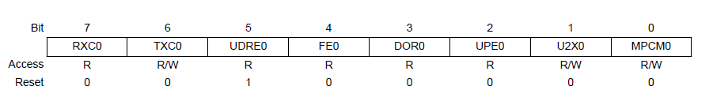
UCSR0A: USART Control and Status Register 0A
Bit 7: RXC0 – USART Receive Complete Flag:
This flag bit is set by the CPU when there are unread data in the Receive buffer and is cleared by the CPU when the receive buffer is empty.
Bit 6: TXC0 – USART Transmit Complete Flag:
This flag bit is set by the CPU when the entire frame in the Transmit Shift Register has been shifted out and there is no new data currently present in the transmit buffer (UDR).

Slide 44
UCSR0A(Contd.).
Bit 5: UDRE0– USART Data Register Empty:
The UDRE Flag indicates if the transmit buffer (UDR) is ready to receive new data. If UDRE is one, the buffer is empty, and therefore ready to be written.
Bit 4: FE0 – Frame Error:
This bit is set if the next character in the receive buffer had a Frame Error when received (i.e. when the first stop bit of the next character in the receive buffer is zero).
Bit 3: DOR0 – Data Overrun Error:
This bit is set if a Data OverRun condition is detected. A Data OverRun occurs when the receive buffer is full (two characters), and a new start bit is detected.

Slide 45
UCSR0A(Contd.).
Bit 2: PE0 – Parity Error:
This bit is set if the next character in the receive buffer had a Parity Error when received and the parity checking was enabled at that point (UPM1 = 1).
Bit 1: U2X0 – Double Transmission Speed:
Writing this bit to one will make Asynchronous mode run at double speed.
Bit 0: MPCM0 – Multi-Processor Communication Mode:
This bit enables the Multi-processor Communication mode. When the MPCM bit is written to one, all the incoming frames received by the USART Receiver that do not contain address information will be ignored.

Slide 46
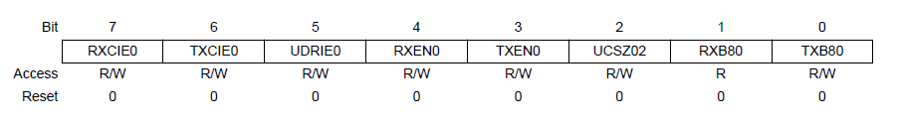
UCSR0B: USART Control and Status Register 0B:
Bit 7: RXCIE0 – RX Complete Interrupt Enable:
Writing this bit to one enables interrupt on the RXC Flag.
Bit 6: TXCIE0 – TX Complete Interrupt Enable:
Writing this bit to one enables interrupt on the TXC Flag. Bit 5: UDRIE – USART Bit 5: UDRIE0 - Data Register Empty Interrupt Enable:
Writing this bit to one enables interrupt on the UDRE Flag.
Bit 4: RXEN0 – Receiver Enable:
Writing this bit to one enables the USART Receiver. The Receiver will override normal port operation for the RxD pin when enabled.

Slide 47
UCSR0B(Contd.)
Bit 3: TXEN0 – Transmitter Enable:
Writing this bit to one enables the USART Transmitter. The Transmitter will override normal port operation for the TxD pin when enabled.
Bit 2: UCSZ02 – Character Size:
The UCSZ2 bits combined with the UCSZ1:0 bits in UCSRC register sets the number of data bits (Character Size).
Bit 1: RXB08 – Receive Data Bit 8:
RXB8 is the ninth data bit of the received character when operating with serial frames with nine data bits. It must be read before reading the low bits from UDR.
Bit 0: TXB08 – Transmit Data Bit 8:
TXB8 is the ninth data bit in the character to be transmitted when operating with serial frames with nine data bits. It must be written before writing the low bits UDR.

Slide 48
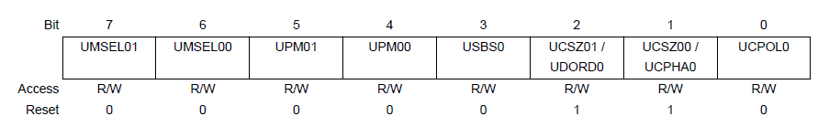
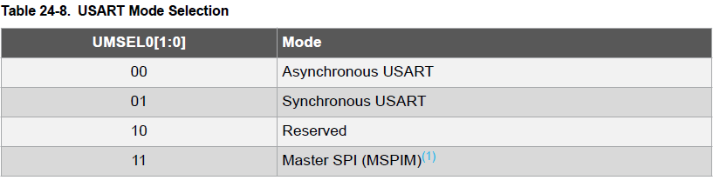
UCSR0C: USART Control and Status Register 0C
Bit 7-6 : UMSEL0[1:0] – Mode Selector
These bits are used to select the operating mode of USART. Between Synchronous and Asynchronous

Slide 49
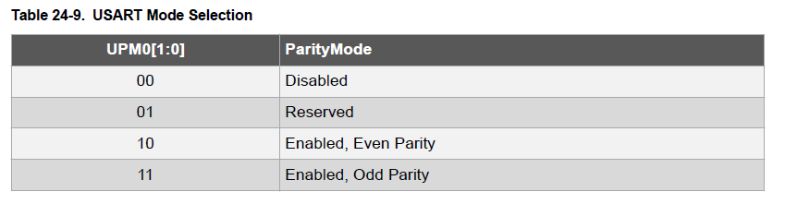
UCSR0C(Contd.):
Bit 5-4: UPM01:0 – Parity Mode:
This bit helps you enable/disable/choose the type of parity.

Slide 50
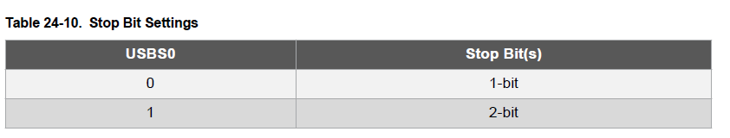
UCSR0C(Contd.):
Bit 3: USBS0 – Stop Bit Select:
This bit selects the number of stop bits to be inserted by the Transmitter.

Slide 51
UCSR0C(Contd.):
Bit 2-1: UCSZ0[1:0] – Character Size:
These two bits in combination with the UCSZ02 bit in UCSR0B register helps choosing the number of data bits in your frame
Bit 0: UCPOL0 – Clock Polarity:
This bit is used for Synchronous mode only. Write this bit to zero when Asynchronous mode is used. The UCPOL bit sets the relationship between data output change and data input sample, and the synchronous clock (XCK).

Slide 52
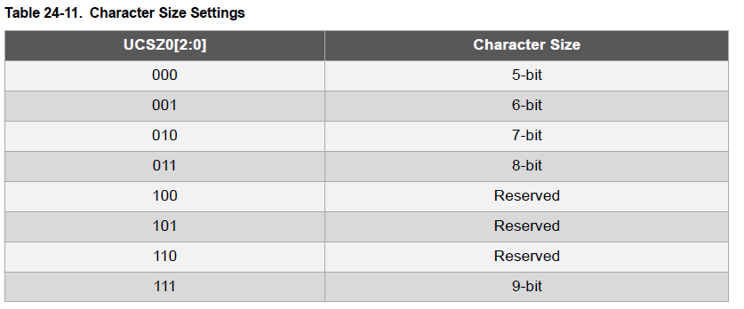
UCSR0C(Contd.):

Slide 53
Coding:
Q. Write a code to configure USART at 9600bps, Asynchronous Mode, Normal Speed, No parity, 1 Stop bit and 8 bit of data.
ANS:
UCSR0A = 0X00;
UCSR0B = (1<<RXEN0) | (1<<TXEN0);
UCSR0C = (1<<UCSZ01) | (1<<UCSZ00);
UBRR0 = 103;
Q. Write a code to configure USART at 9600bps, Asynchronous Mode, Normal Speed, Even parity, 2 Stop bit and 9 bit of data.
ANS:
UCSR0A = 0X00;
UCSR0B = (1<<RXEN0) | (1<<TXEN0) (1<<UCSZ02);
UCSR0C = (1<<UPM01) | (1<<UCSZ01) | (1<<UCSZ00) | (1<<USBS0);
UBRR0 = 103;

Slide 54
Task:
Turning ON/OFF a LED by using USART in UNO

Slide 55
Coding:
We will use our Laptop as the other device for sending the commands over serial communication.
To use serial communication we will use Serial Monitor.
When we will send 1 the LED should turn ON.
When we will send 0 is should turn OFF

Slide 56
Coding(Contd.):
#include<avr/io.h>
void usart_init() {
UCSR0A = 0X00;
UCSR0B = (1<<RXEN0) | (1<<TXEN0);
UCSR0C = (1<<UCSZ01) | (1<<UCSZ00);
UBRR0 = 103;
}
char usart_read() {
while( !(UCSR0A & (1<<RXC0))) { }
return UDR0;
}
void usart_write(char data) {
while( !(UCSR0A & (1<<UDRE0))) { }
UDR0=data;
}
int main(void) {
char ch;
usart_init();
DDRB=0x00;
PORTB=0x00;
while(1) {
ch=usart_read();
if(ch==‘0’) {
PORTB=0x00;
usart_write(‘O’);
usart_write(‘K’);
}
else if(ch==‘1’) {
PORTB=0xFF;
usart_write(‘O’);
usart_write(‘K’);
}
}
return 0;
}

Slide 57
Thank You

